Slide 1

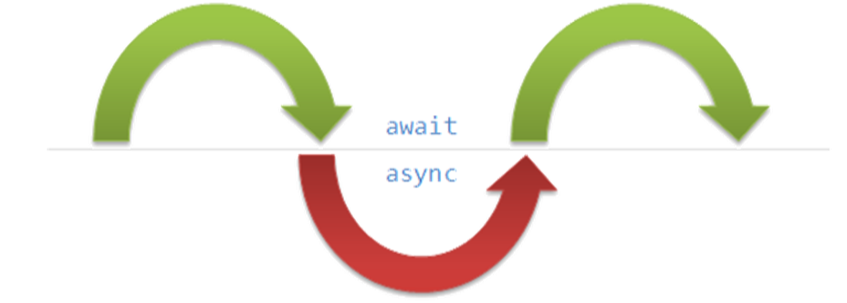
State Management Asynchronous Processing
Cookies and Sessions Writing Concurrent Code in C#
SoftUni Team
Technical Trainers
Software University
https://softuni.bg

Slide 2
Have a Question?
sli.do #csharp-web

Slide 3
Table of Contents
State Management
Cookies
Sessions
Session vs Cookies
Asynchronous Processing
Synchronous Programming
Asynchronous Programming
Threads
Tasks in C# (async and await)

Slide 4

HTTP Cookies
Usages and Control

Slide 5


What Are Cookies?
A small file of plain text with no executable code
Sent by the server to the client's browser
Stored by the browser on the client's device (computer, tablet, etc.)
Hold small piece of data for a particular client and a web site

Slide 6

What Are Cookies Used for?
Session management
Logins, shopping carts, game scores or anything else the server should remember
Personalization
User preferences, themes and other custom settings
Tracking
Recording and analyzing user behavior
Breakfast
But that's not what we are currently talking about

Slide 7


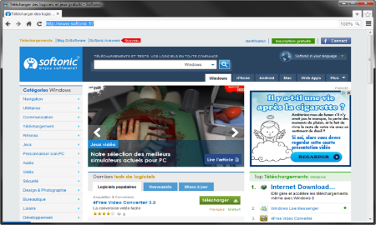



Session Management
The HTTP object is stateless
It doesn't store information about the requests
Web Client
Web Application
GET
POST
GET
Not stored

Slide 8
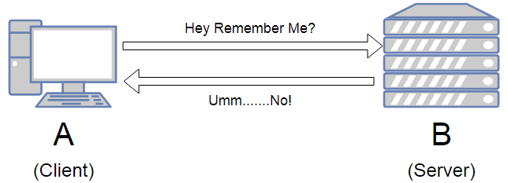
Stateless HTTP – the Problem
The server doesn't know if two requests come from the same client
State management problems
Navigation through pages requires authentication each time
Information about the pages is lost between the requests
Harder personalization of functionality of pages

Slide 9
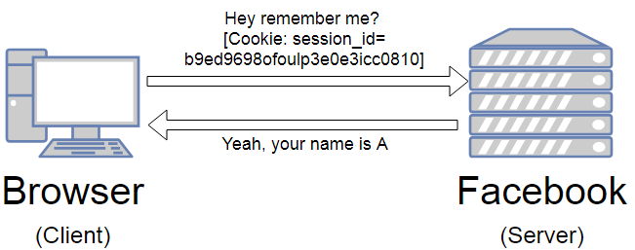
Stateless HTTP – the Cookie Solution
A reliable mechanism for websites to remember stateful information
To know whether the user is logged in or not
To know which account the user is logged in with
To record the user's browsing activity
To remember pieces of information previously entered into form fields (usernames, passwords, etc.)

Slide 10
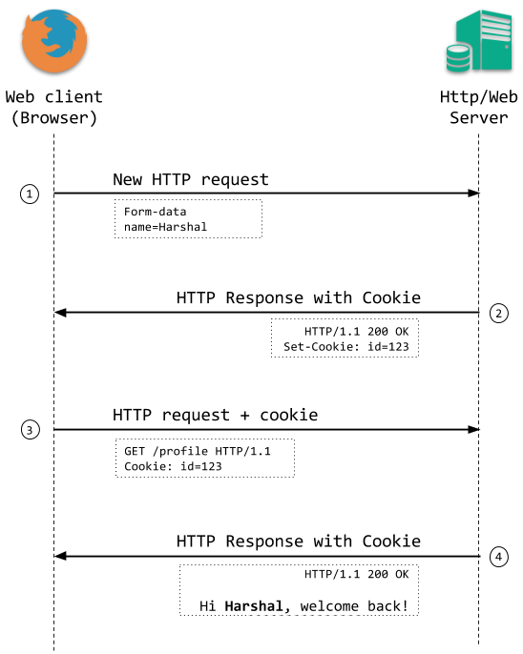
How Are Cookies Used?
The response holds the cookies to be saved within the Set-Cookie header
The request holds the specific web site cookie within the Cookie header
HTTP/1.1 200 OK
Set-Cookie: lang=en
GET www.example.bg HTTP/1.1
Cookie: lang=en

Slide 11
Server-Client Cookies Exchange
http://www.example.bg/
Web Client
Web Application
GET www.example.bg HTTP/1.1
HTTP/1.1 200 OK Set-Cookie: lang=en
GET www.example.bg HTTP/1.1
Cookie: lang=en

Slide 12
Cookie Structure
The cookie consists of Name, Value and Attributes (optional)
The attributes are key-value pairs with additional information
Attributes are not included in the requests
Attributes are used by the client to control the cookies
Name=Value
Attributes
Set-Cookie: SSID=Ap4P…GTEq; Domain=foo.com; Path=/; Expires=Wed, 13 Jan 2021 22:23:01 GMT; Secure; HttpOnly

Slide 13
Scope
Defined by the attributes Domain and Path
Domain – defines the website that the cookie belongs to
Path – Indicates a URL path that must exist in the requested resource before sending the Cookie header
Set-Cookie: SSID=Ap4P…GTEq; Domain=foo.com; Path=/; Expires=Wed, 13 Jan 2021 22:23:01 GMT; Secure; HttpOnly

Slide 14
Lifetime
Defined by the attributes Expires and Max-Age
Expires – defines the date the browser should delete the cookie
By default the cookies are deleted after the end of the session
Max-Age – interval of seconds before the cookie is deleted
Set-Cookie: SSID=Ap4P…GTEq; Domain=foo.com; Path=/; Expires=Wed, 13 Jan 2021 22:23:01 GMT; Secure; HttpOnly

Slide 15
Security
Security flags do not have associated values
Secure - tells the browser to use cookies only via secure/encrypted connections
HttpOnly – defines that the cookie cannot be accessed via client-side scripting languages
Set-Cookie: SSID=Ap4P…GTEq; Domain=foo.com; Path=/; Expires=Wed, 13 Jan 2021 22:23:01 GMT; Secure; HttpOnly

Slide 16
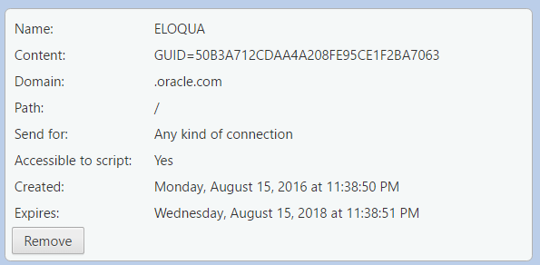
What is in the Cookie?
The cookie file contains a table with key-value pairs

Slide 17



Third Party Cookies
Cookies stored by an external party (different domain)
Mainly used for advertising and tracking across the web
http://stackoverflow.com/
Web Client
Web Application
Cookie transfer
Cookie transfer
Third Party

Slide 18

HTTP Sessions

Slide 19
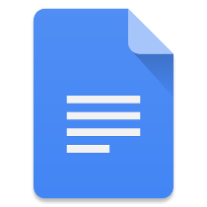
What Are Sessions?
A way to store information about a user to be used across multiple pages
/login
Web Application
Session
/home
user: Teo
/products

Slide 20
Session Management
The exchange mechanism be used between the user and the web application
First Time Login
Web Client
Web Application
User credentials
Session ID

Slide 21
Session Management
The exchange mechanism be used between the user and the web application
Browsing Pages
Web Client
Web Application
Session ID
Requested data + Session ID

Slide 22
Session Management
The exchange mechanism be used between the user and the web application
Browsing pages after
the server is restarted
Web Client
Web Application
Session ID
Requested Data + Session ID

Slide 23
Relation with Cookies
Session Store
sid 5 { uid: 101 }
sid 7 { uid: 102 }
Cookie {
name: sid value: 5
}
Validate
Req
Web Application
Session
Resp
Database
Cookie {
name: sid value: 7
}
Req
Get data
uid name 101 Teo
102 Bojo
Resp
Create personal web page

Slide 24
Session Structure
"hje85d3" : {
user_id: 789
username: FirstUser
},
"af354dd" : {
user_id: 456
username: SecondUser
},
"fg78e5s" : {
user_id: 654
username: ThirdUser
}
Unique
Session ID
Key-Value pairs with user data

Slide 25
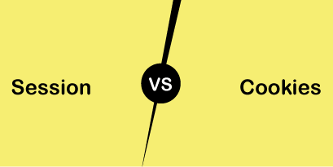
Session vs Cookies
Differences and Usage

Slide 26
Session vs Cookies
Session
Stored on the server
Expires when the user closes the browser
It can store an unlimited amount of data
Depends on the cookie
Secure –saves data in encrypted form and cannot be accessed by anyone easy
Cookies
Stored on the user's computer as a text file
Expires on its expiration date
It can store only limited data
Does not depend on the session
Have security issues, as data is stored in a text file and it can be accessed by anyone easily

Slide 27

Synchronous Programming
Benefits and Drawbacks

Slide 28
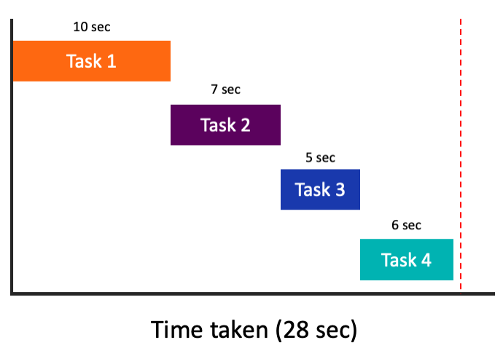
Synchronous Programming
Executing program components sequentially
"Sequential programming"
Actions happen one after another
Components wait for previous
components to finish
Program resources are
accessible at all points

Slide 29
Synchronous Code
static void Main()
{
int n = int.Parse(Console.ReadLine());
PrintNumbersInRange(0, 10);
Console.WriteLine("Done.");
}
static void PrintNumbersInRange(int a, int b)
{
for (int i = a; i <= b; i++)
{
Console.WriteLine(i);
}
}
int n = int.Parse(..)
PrintNumbersInRange()
Console.WriteLine(..)
...
Synchronous code is executed step by step

Slide 30
Synchronous Code – Long Running Operation
Console.Write("Enter your name: ");
string name = Console.ReadLine();
for (int i = 0; i < int.MaxValue; i++)
{
// Execute some operations here
}
Console.WriteLine($"Hello, {name}!");
You will have to wait for the long-running operation to finish before you can see the greeting

Slide 31

Synchronous Programming Drawbacks
If one component is blocked, the entire program is blocked
UI may become unresponsive
No utilization of multi-core systems
CPU-demanding tasks delay execution of all other tasks
Accessing resources blocks entire program
Especially problematic with web resources

Slide 32

Asynchronous Programming
Benefits and Drawbacks

Slide 33
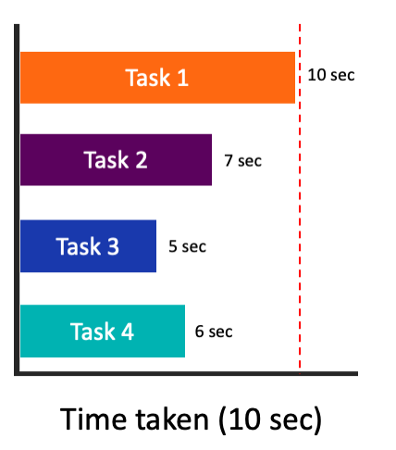
Asynchronous Programming
Program components can execute in parallel
Some actions run alongside other actions
Each action can happen in a separate thread
Independent components don't wait for each other
Program resources shared between threads
If one thread uses a resources, others shouldn't use it

Slide 34
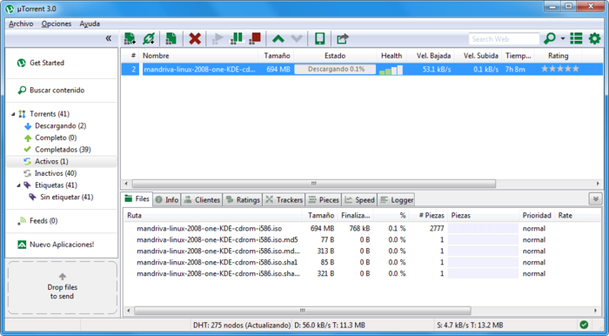

Asynchronous Programming – Benefits
If a component is blocked, other components still run
UI runs separately and always remains responsive
Utilization of multi-core systems
Each core executes one or more threads
CPU-demanding tasks run on "background" threads
Resource access runs on "background" threads

Slide 35
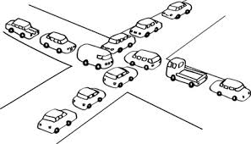
Asynchronous Programming – Drawbacks
Hard to know which code parts are running at a specific time
Harder than usual to debug
Have to protect resources
One thread uses a resource
Other threads must wait for the resource
Hard to synchronize resource access
Deadlocks can occur

Slide 36
Asynchronous Code
Asynchronous programming allows the execution of code simultaneously
int n = int.Parse(Console.ReadLine());
PrintNumbersInRange(0, 100);
var task = Task.Run(() =>
PrintNumbersInRange(100, 200));
Console.WriteLine("Done.");
task.Wait();
int n = int.Parse(..)
for (0..100)
Console.WriteLine(…)
for (100..200)
Wait()

Slide 37

Threads
Call Stack, Thread-Safety, Exception Handling

Slide 38
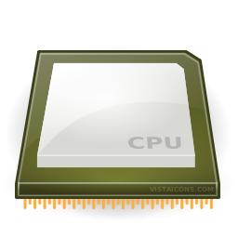
Instruction Execution
Each program's code is translated to CPU instructions
Program.cs
int a = 5;
int b = 4;
Console.WriteLine(a + b);
Compilation
Program.exe
Single-Core CPU
00DA2655 mov dword ptr [ebp-40h],5
00DA265C mov dword ptr [ebp-44h],4
00DA2663 mov ecx,dword ptr [ebp-40h]
00DA2666 add ecx,dword ptr [ebp-44h]
00DA2669 call 73B5A920
00DA266E nop
Instructions are executed one by one

Slide 39
Multi-Tasking
A computer can run many processes (applications) at once
But each CPU core can only execute one instruction at a time
Parellelism is achieved by the operating system's scheduler
Grants each thread a small interval of time to run
program.exe
chrome.exe
winamp.exe
system.exe
program.exe
...
0 5 10 15 20 25 ms
Notes:
s

Slide 40
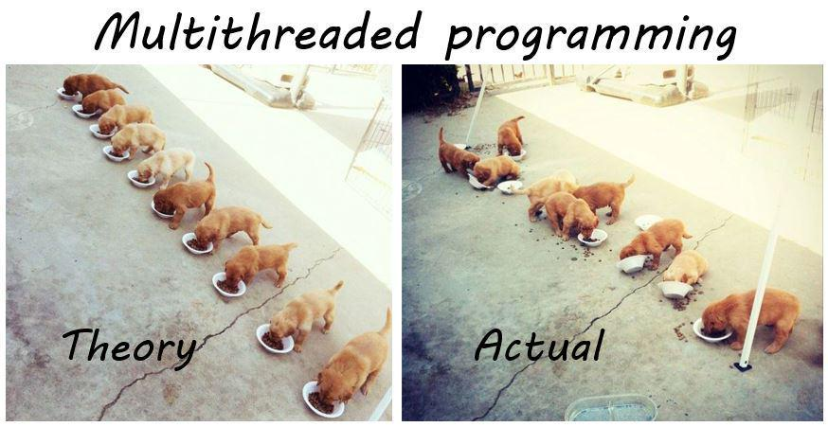
Threads
A thread is a fundamental unit of code execution
Commonly, processes (programs) use more than one thread
In .NET, there is always more than one thread (e.g. GC)
Each thread has a memory area associated with it known as a Call Stack
Stores local variables
Stores the currently invoked methods in order of invocation

Slide 41
Threads in C#
Threads in C# can be created using the System.Thread class
Constructor accepts a method (delegate) to execute on a separate thread
Thread thread = new Thread(() =>
{
for (int i = 0; i < 10; i++)
{
Console.WriteLine(i);
}
});

Slide 42
System.Thread
Start() – schedules the thread for execution
Join() – waits for the thread to finish its work (blocks the calling thread)
Thread primes = new Thread(() => PrintPrimesInRange(1, 10000));
primes.Start();
Console.WriteLine("Waiting for thread to finish work...");
primes.Join();

Slide 43
Thread – Example
List<long> numbers = new List<long>();
Thread t = new Thread(() =>
SumOddNumbers(numbers, 10, 100000000L));
t.Start();
Console.WriteLine("What should I do?");
while (true)
{
string command = Console.ReadLine();
if (command == "exit") break;
}
t.Join();
Console interface
remains unblocked

Slide 44
Thread Stack
Each thread has its own stack
The start (bottom) of the stack is the method from which the thread began execution
Each method (frame) stores local variables
...
IsPrime()
PrintAllPrimes()
Main()
...
IsValidUrl
DownloadAsync
background thread
main thread

Slide 45

Thread Race Conditions
A race condition occurs when two or more threads access shared data and they try to change it at the same time
List<int> numbers = Enumerable.Range(0, 10000).ToList();
for (int i = 0; i < 4; i++)
{
new Thread(() =>
{
while (numbers.Count > 0)
numbers.RemoveAt(numbers.Count - 1);
}).Start();
}

Slide 46

Thread Safety
A thread-safe resource can be safely accessed by multiple threads
lock keyword grants access to only one thread at a time
Avoids race conditions
Blocks any other threads until the lock is released
lock (numbers)
{
if (numbers.Count == 0) break;
int lastIndex = numbers.Count - 1;
numbers.RemoveAt(lastIndex);
}

Slide 47
Exception Handling
Exceptions cannot be handled outside a thread
try
{
new Thread(DoWork).Start();
}
catch (Exception ex)
{
Console.WriteLine("Exception!");
}
This part will never be reached
public static void DoWork()
{
throw new ArgumentNullException();
}

Slide 48
Exception Handling – the Right Way
new Thread(DoWork).Start();
public static void DoWork()
{
try
{
throw new ArgumentNullException();
}
catch (Exception ex)
{
Console.WriteLine("Exception handled!");
}
}
Exceptions should be handled inside the executed method(s)

Slide 49

Tasks in C#
Task Parallel Library

Slide 50
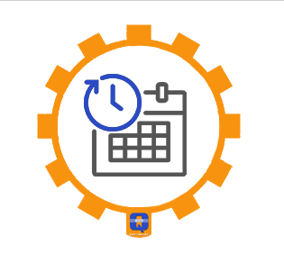
Tasks in C#
A task is a high-level representation of concurrent work
Runs in parallel with the main thread
May not run on a new thread (the CLR decides)
Offers several operations
Creating, running and returning result
Continuing with another task (chaining several operations)
Proper exception handling
Progress/state reports

Slide 51
Creating Tasks in C#
Creating tasks can be done in several ways
Initialize a new Task object
Task.Run()
Task.Factory.StartNew() – enables additional task customization
Task task = new Task(() => { Console.WriteLine(""); });
Task.Run(() => TraverseMatrix());
Task.Factory.StartNew(() => CopyFileContents("got-s03ep1.avi"),
TaskCreationOptions.LongRunning);

Slide 52
Generic Tasks
Task<T> is a task that will return a result sometime in the future
Task<long> task = Task<long>.Run(() =>
{
long sum = 0;
for (int i = 0; i < 10000; i++) sum += i;
return sum;
});
Console.WriteLine(task.Result);
Blocks the calling thread until the task returns a result

Slide 53
Task Exception Handling
Exceptions that have occurred within the body of a Task can be captured and handled outside of it
var task = SliceAsync(VideoPath, DestinationPath, 5);
try
{
task.Wait();
}
catch (AggregateException ex)
{
// Handle exception...
}
You can use the AggregateException to wrap all exceptions thrown by different threads

Slide 54
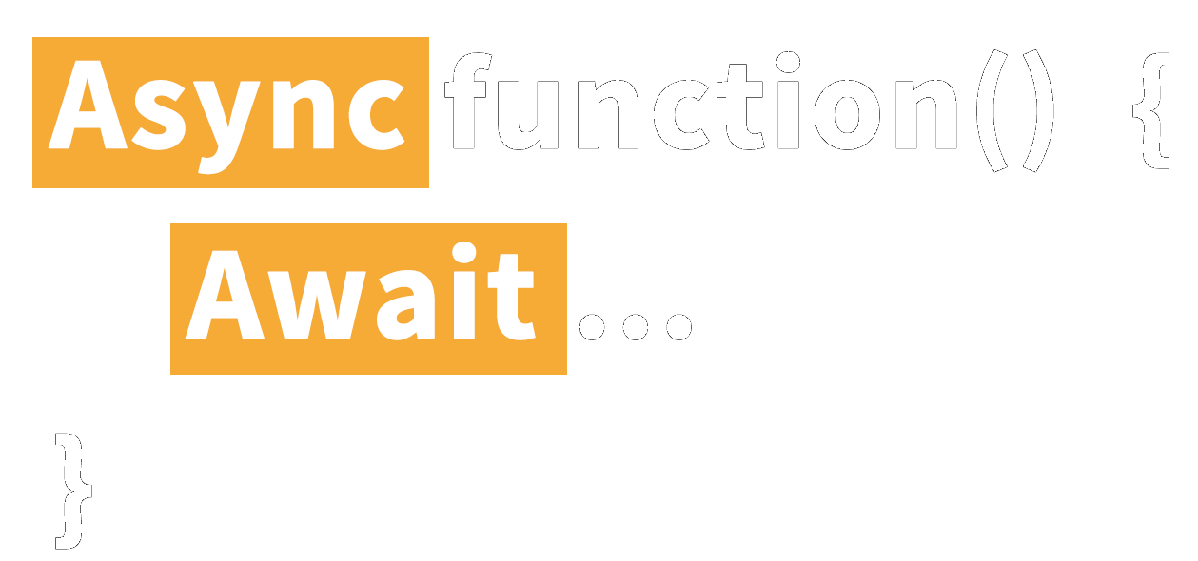
Async and Await
Keywords for Asynchronous Operations

Slide 55
Tasks with Async and Await
The keywords async and await are always used together
async hints the compiler that the method might run in parallel
Does not make a method run asynchronously (await makes it)
Tells the compiler "this method could wait for a resource or operation"
If it starts waiting, return to the calling method
When the wait is over, go back to called method
static async void SliceFileAsync(string file, int parts)

Slide 56
Tasks with Async and Await
await is used in a method which has the async keyword
Saves the context in a state machine
Marks waiting for a resource (a task to complete)
Resource should be a Task<T>
Returns T result from Task<T> when it completes
await DownloadStringAsync("https://softuni.org");
Returns Task<string>

Slide 57
Async and Await – Example
static void Main()
{
DownloadFileAsync(FileUrl, "book.pdf");
// Do some other work
}
static async void DownloadFileAsync(string url, string fileName)
{
Console.WriteLine("Downloading...");
await Task.Run(() =>
{
// Download the file
});
Console.WriteLine("Download successful.");
}
After the method is over the calling thread gets back to the calling method
The calling thread exits the method on await
When the waiting is over, the calling thread proceeds with method execution

Slide 58

Summary
State management
Cookies are client based stored information
Sessions are server-based information
Asynchronous processing
A thread is a unit of code execution
Multithreading
Tasks facilitate the work with multithreading
async and await keywords
…
…
…

Slide 59









Questions?

Slide 60










SoftUni Diamond Partners

Slide 61
Trainings @ Software University (SoftUni)
Software University – High-Quality Education, Profession and Job for Software Developers
softuni.bg, about.softuni.bg
Software University Foundation
softuni.foundation
Software University @ Facebook
facebook.com/SoftwareUniversity
61
Notes:
61

Slide 62

License
This course (slides, examples, demos, exercises, homework, documents, videos and other assets) is copyrighted content
Unauthorized copy, reproduction or use is illegal
© SoftUni – https://about.softuni.bg
© Software University – https://softuni.bg
Notes:
62

